Slide 1
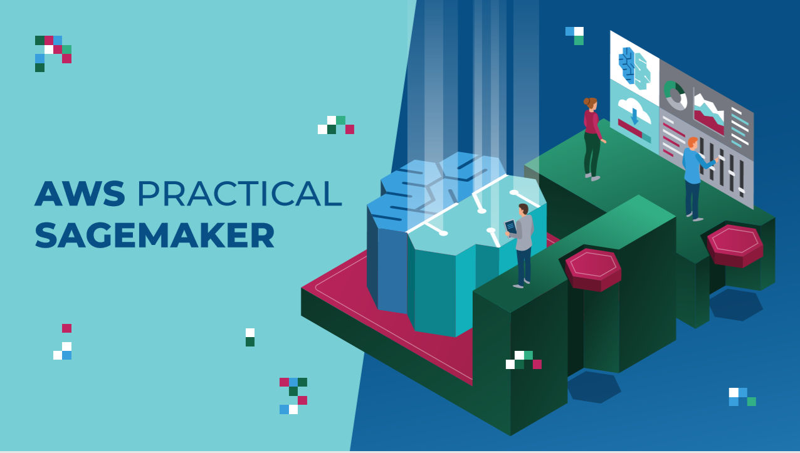

Slide 2

WHAT IS AMAZON WEB SERVICES (AWS) & CLOUD COMPUTING?

Slide 3


WHAT IS AWS?
Compute
Storage
Databases
Networking
Analytics
Machine learning & Artificial intelligence (AI)
Internet of Things (IoT)
Amazon Web Services (AWS) is the world’s top cloud platform.
AWS offers more than 165 fully featured services (40 of them are not offered anywhere else!).
AWS is adopted by millions of customers globally including small and large scale enterprises.
AWS enables companies to be more agile, flexible, secure at a fraction of the cost.
AWS provides services for broad range of applications such as:
Photo Credit: https://commons.wikimedia.org/wiki/File:AmazonWebservices_Logo.svg

Slide 4
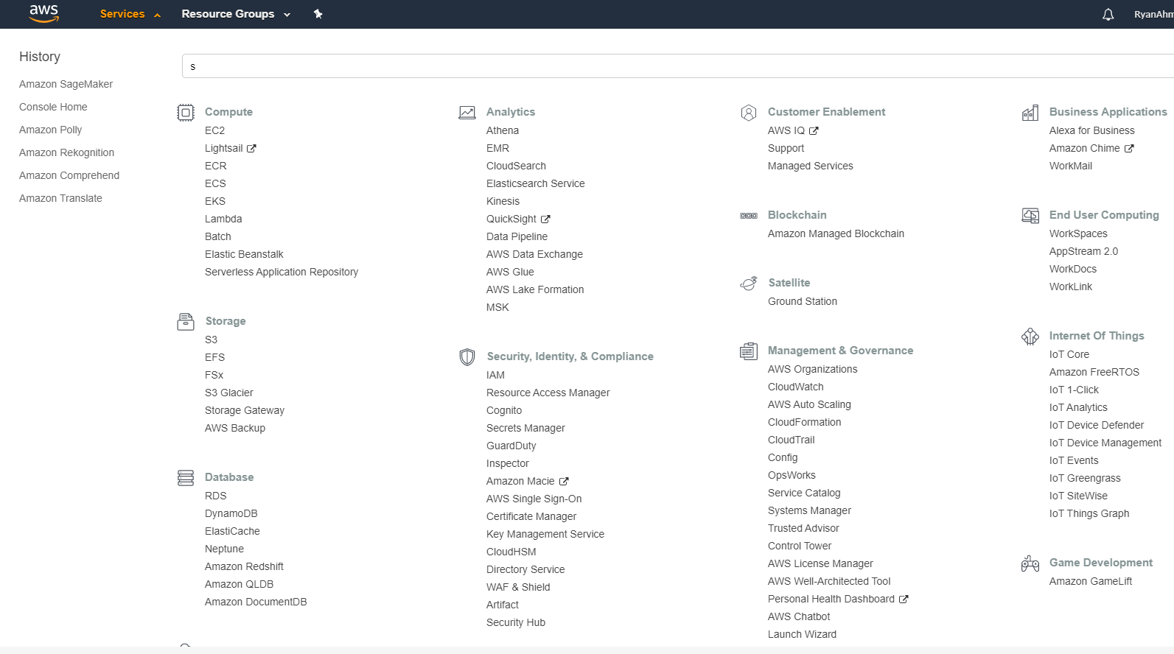
AWS SERVICES OVERVIEW:
Let’s go on an AWS Tour!

Slide 5

WHAT IS CLOUD COMPUTING?
Cloud computing is the on-demand delivery of services such as compute and storage over the Internet with pay-as-you-go pricing.
Simply put, instead of buying a physical server or a computer, you can lease it!
You can leverage compute power, storage, and databases, on an as-needed basis from a cloud provider like Amazon Web Services (AWS).
Photo Credit: https://pixabay.com/illustrations/cloud-computing-cloud-system-cloud-2153286/

Slide 6

WHO USES CLOUD COMPUTING?
Many companies with various sizes rely in cloud computing for many applications such as:
Virtual Desktops
Storage and data backup
Big Data Analytics
Disaster recovery
E-mail
Machine Learning for forecasting and predictions
Example: Banks and financial institutions rely on cloud computing to prevent fraudulent transactions in real-time.
Photo Credit: https://www.flickr.com/photos/159124985@N05/37845654022

Slide 7
WHAT ARE THE BENEFITS OF CLOUD COMPUTING?
AGILITY
Cloud computing empowers companies to be agile.
ELASTICITY
Cloud computing allows for scaling and shrinking resources based on demand.
COST SAVINGS
Cloud computing trades capital expenses such as buying physical servers for variable expenses.
DEPLOY GLOBALLY IN MINUTES
AWS infrastructure is available all over the world.
Instead of buying physical hardware and software and setting them up which might take months, cloud computing gives companies access to numerous technologies which enables faster deployment and innovation.
In minutes, companies can provision and deploy resources such as compute, storage, and databases.
This empowers companies to be more agile and give them freedom to experiment with new ideas faster.
Therefore, there is no need to over-provision resources up front.
Massive savings with economies of scale.
Companies can deploy services in any corner of the planet in minutes by leveraging cloud.
Placing applications near the customer is critical to improve latency and performance.

Slide 8
AWS REGIONS AND AVAILABILITY ZONES

Slide 9
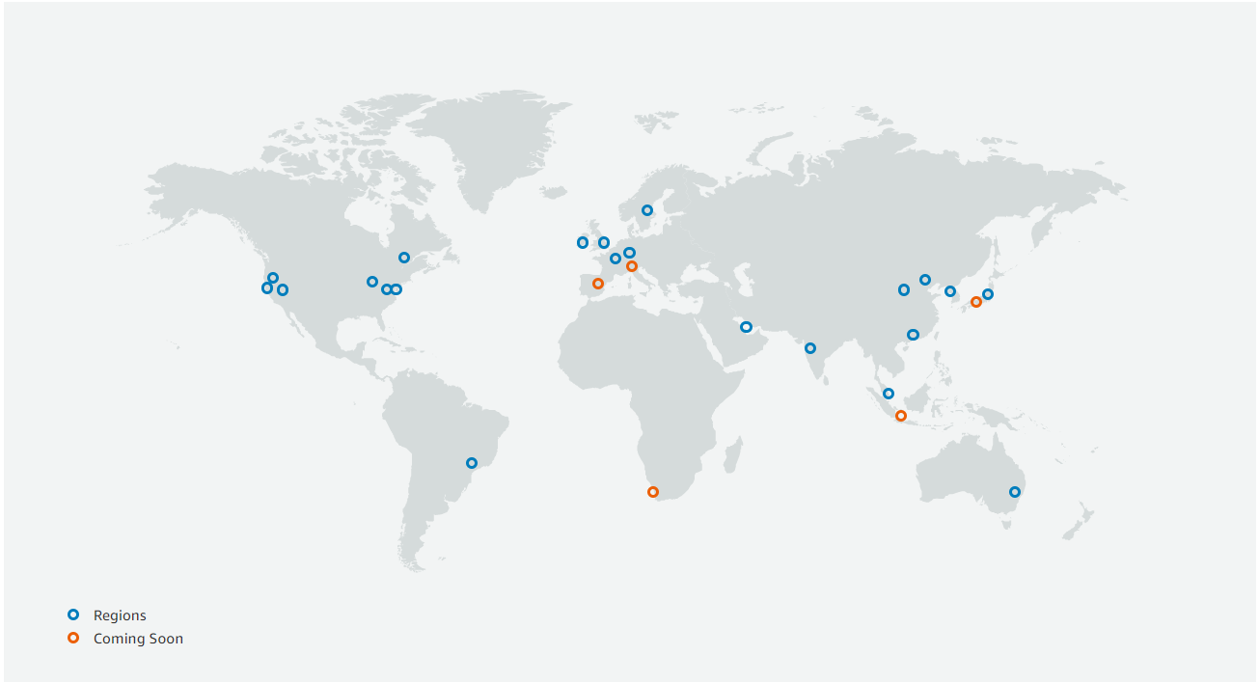
AWS GLOBAL INFRASTRUCTURE MAP
AWS now spans 69 Availability Zones within 22 geographic regions around the world
Photo Credit: https://aws.amazon.com/about-aws/global-infrastructure/

Slide 10
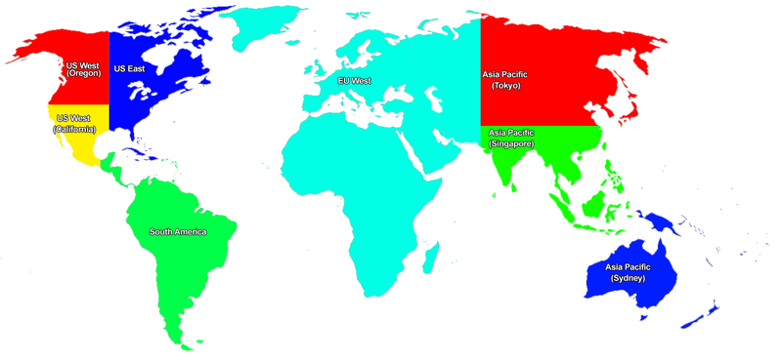
WHAT IS A REGION?
An AWS Region is a geographical location that contains a number of availability zones (data centers).
Every region is physically separate from all other regions.
Every region has its own independent power and water supply.
Regions are important to ensure:
(1) Data compliance
(2) Latency (data centers are placed close to users to reduce latency)
us-east-1 is the largest AWS region and contains of five zones.
https://en.m.wikipedia.org/wiki/File:Aws_region_map.png

Slide 11

WHAT IS AN AVAILABILITY ZONE?
An AWS availability zone is a logical data center that is located in a certain region.
There are two or more availability zones in every AWS region.
In order to ensure availability and reduce the likelihood of having two zones going down at the same time, each zone has a redundant and separate power and networking.
Note: A data center consists of bunch of servers
Note: A common misconception is that a single zone equals a single data center. In fact, each zone is backed by one or more physical data centers.
REGION
AVAILABILITY ZONE A
AVAILABILITY ZONE B
AVAILABILITY ZONE C
https://commons.wikimedia.org/wiki/File:BalticServers_data_center.jpg

Slide 12
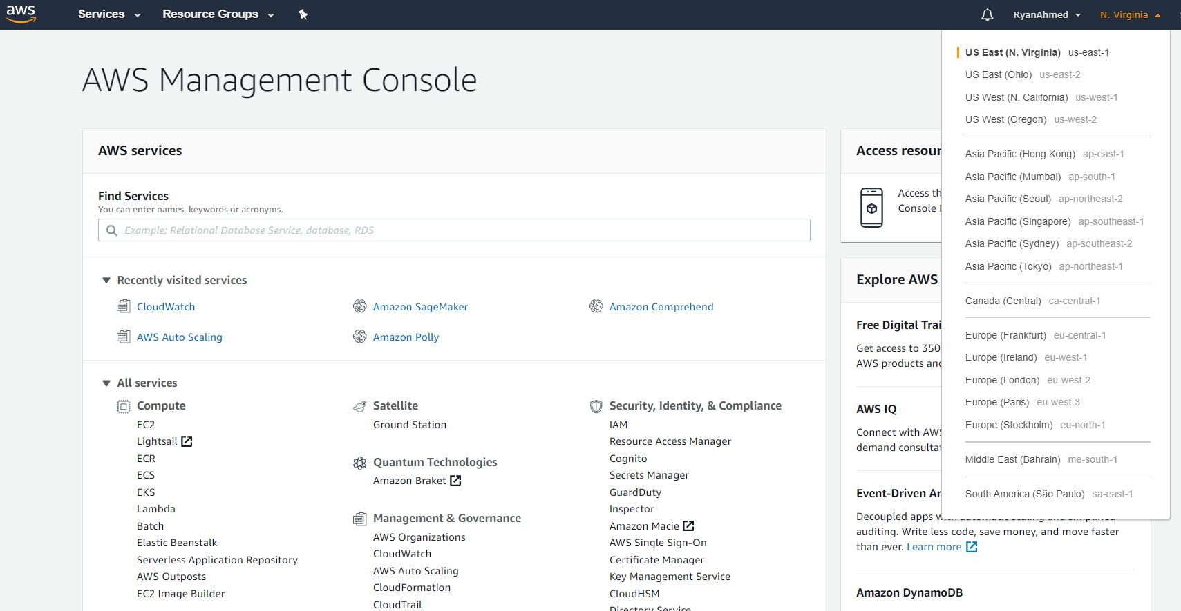
REGIONS SELECTION FROM THE AWS CONSOLE

Slide 13
KEY MACHINE LEARNING COMPONENTS

Slide 14
MACHINE LEARNING COMPONENTS?
1. DATA
2. MODEL
3. COMPUTE

Slide 15
AWS SERVICES: STORAGE AND COMPUTE
3
1

Slide 16
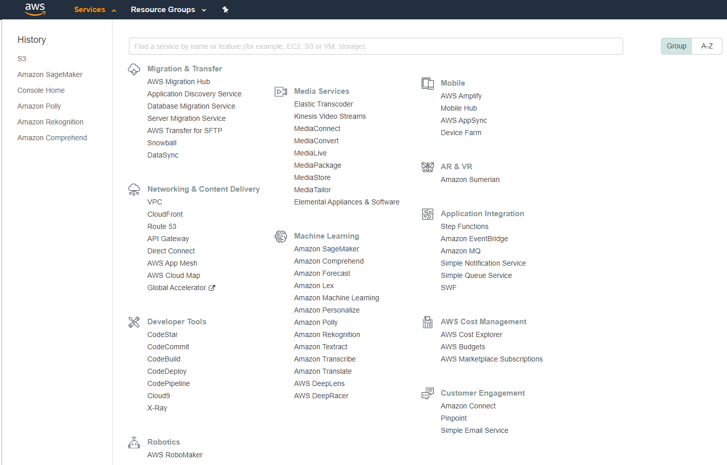
AWS SERVICES: MACHINE LEARNING
2

Slide 17
AMAZON S3

Slide 18


WHAT IS AMAZON S3?
Amazon Simple Storage Service (Amazon S3) is a storage service that allows enterprises/individuals to store and protect any amount of data.
Amazon S3 offers numerous enhanced features such as:
(1) Scalability
(2) Data availability
(3) Security
(4) Performance
Amazon S3 is extremely easy to use and allows enterprises to organize their data and configure finely-tuned access controls.
Amazon S3 extremely durable to 99.999999999% (11 9’s).
Amazon S3 is 99.9% available.
Photo Credit: https://commons.wikimedia.org/wiki/File:AWS_Simple_Icons_AWS_Cloud.svg
Photo Credit: https://commons.wikimedia.org/wiki/File:AWS_Simple_Icons_Storage_Amazon_S3.svg

Slide 19
WHAT IS AMAZON S3? CONTINUED
Amazon Simple Storage Service (Amazon S3) is built to be extremely simple and robust.
Amazon S3 allows customers to store data in buckets or directories (much like folders).
A bucket is a container for objects stored in Amazon S3. Every object is contained in a bucket.
Each of the buckets will have global (universal) unique name.
So you cannot have the same bucket name as somebody else!
You can store an infinite amount of data in a bucket in which each object can contain up to 5 TB of data.
For example, if we have an object images/mycat.jpg is stored in the mitchsteve bucket, use can use the following URL to access it:
http://mitchsteve.s3.amazonaws.com/images/mycat.jpg
Photo Credit: https://commons.wikimedia.org/wiki/File:AWS_Simple_Icons_AWS_Cloud.svg
Photo Credit: https://commons.wikimedia.org/wiki/File:AWS_Simple_Icons_Storage_Amazon_S3.svg

Slide 20
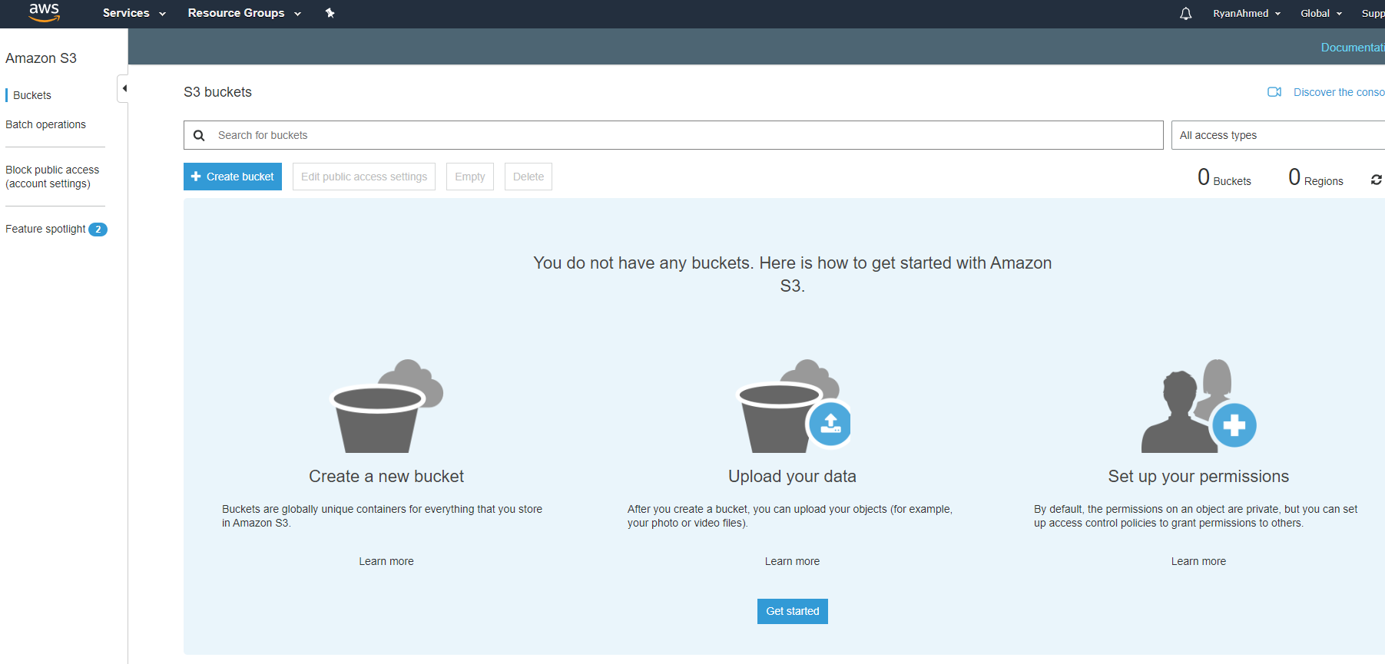
WHAT IS AMAZON S3?
CREATE A BUCKET AND SIMPLY UPLOAD DATA TO IT

Slide 21
AMAZON ELASTIC COMPUTE CLOUD (EC2)

Slide 22


AMAZON EC2: INTRODUCTION
Amazon Elastic Compute Cloud (Amazon EC2) offers resizable compute capacity in the cloud.
AWS EC2 can be used to acquire, configure and scale capacity in a very easy fashion.
EC2 is a service that allows you to simply rent a server in the cloud.
EC2 offers 7x fewer downtime hours than the next largest cloud provider.
EC2 covers 22 regions and 69 availability zones all over the world.
Note: EC2 is a compute service which is NOT serverless (lambda is serverless).
AMAZON EC2
Photo Credit: https://pixabay.com/photos/transistors-gpu-processor-pc-chip-1137502/

Slide 23
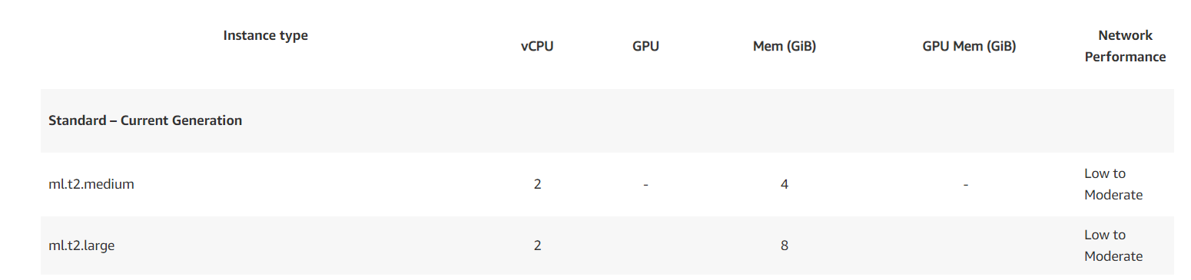
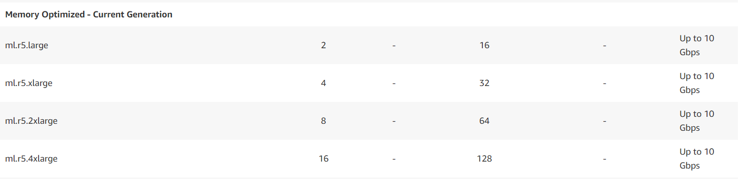
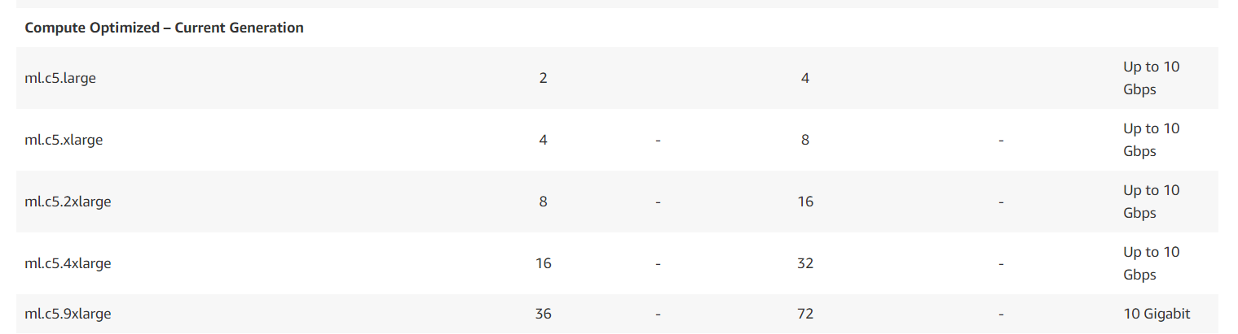
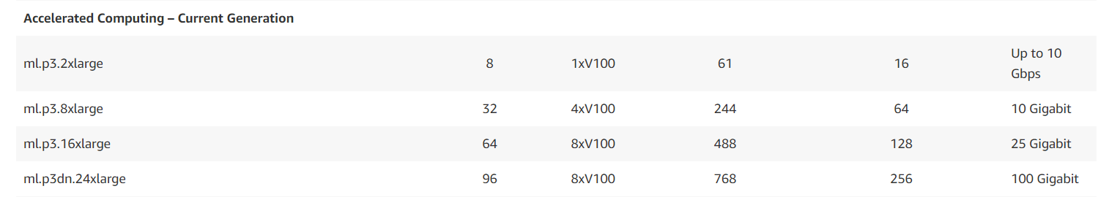
AMAZON EC2: INSTANCE TYPES SELECTION
Check this out for a full list of ML instance Types: https://aws.amazon.com/sagemaker/pricing/instance-types/
STANDARD
MEMORY OPTIMIZED
COMPUTE OPTIMIZED
ACCELERATED COMPUTING

Slide 24
AMAZON EC2: INSTANCE PRICING
ON DEMAND
RESERVED
SPOT
DEDICATED HOST

Slide 25
IDENTITY AND ACCESS MANAGEMENT (IAM)

Slide 26

IDENTITY AND ACCESS MANAGEMENT (IAM): INTRODUCTION
AWS Identity and Access Management (IAM) allows users to securely access and manage AWS services.
AWS IAM is a free and global service, so there is no need to define a region.
IAM allows you to create AWS users and groups and give or deny them access to AWS services such as compute EC2 for example.
AWS Root account is the account you create with your email address and password.
Root account has full administrative access and it is very risky to use it at all time. If these credentials are stolen, someone might mine bitcoin with your account and end up with a very expensive bill.
AWS strongly recommend that you do not use the root user for everyday work. Instead, AWS recommends you create an IAM user and then lock away the root user credentials.
You can use root user credentials only for select few management tasks.
The root account should have an extra layer of security using MFA.
Read More: https://docs.aws.amazon.com/IAM/latest/UserGuide/id_root-user.html
Photo Credit: https://commons.wikimedia.org/wiki/File:Fingerprint_picture.svg

Slide 27
AWS SAGEMAKER

Slide 28
AMAZON SAGEMAKER
Amazon SageMaker is a fully-managed machine learning workflow platform that provides services on data labeling, model building, training, tuning and deployment.
SageMaker allows data scientists and developers to build scalable AI/ML models easily and efficiently.
Models could be deployed in production at a much faster rate and with a fraction of the cost.
Let’s explore SageMaker: https://aws.amazon.com/sagemaker/#
BUILD
SageMaker offers data labeling service
TRAIN
Manage environments for training
DEPLOY
Prebuilt available notebooks with state of the art algorithms on AWS marketplace
Hyperparameters optimization for model tuning
Train models using EC2 instances (on-demand and spot)
Easily deploy and scale models
Autoscaling with 75% savings

Slide 29


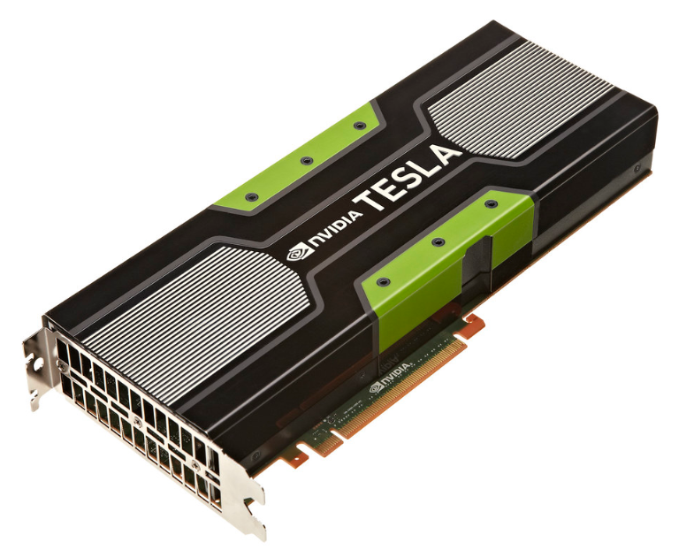
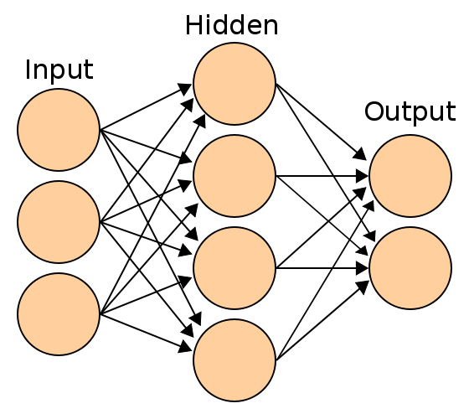
AMAZON SAGEMAKER MODEL TRAINING AND DEPLOYMENT OVERVIEW
Source: https://docs.aws.amazon.com/sagemaker/latest/dg/how-it-works-training.html
https://commons.wikimedia.org/wiki/File:Artificial_neural_network.svg
https://commons.wikimedia.org/wiki/File:AWS_Simple_Icons_Storage_Amazon_S3.svg
https://docs.aws.amazon.com/sagemaker/latest/dg/how-it-works-training.html
https://www.flickr.com/photos/gbpublic/8178512552
CLIENT
END POINT
Inference code image
S3 BUCKET
MODEL ARTIFACTS
MODEL DEPLYMENT/HOSTING
On ML Compute instances
Training code image
MODEL TRAINING
On ML Compute instances
S3 BUCKET
TRAINING BUCKET
EC2 CONTAINER REGISTERY
AMAZON SAGEMAKER

Slide 30
TRAINING/TESTING DATA IN S3
TRAINING DATA
MODEL
TESTING DATA

Slide 31
AMAZON SAGEMAKER COMPONENTS
Two components are present in Amazon SageMaker:
Model training
Model deployment.
To start training an AI/ML model using Amazon SageMaker, you will need to create a training job with the following:
Amazon S3 bucket URL (training data): where the training data is located.
Compute resources: Amazon SageMaker will train the model using instances managed by Amazon SageMaker.
Amazon S3 bucket URL (Output): this bucket will host the output from the training.
Amazon Elastic Container Registry path: where the training code is stored.
Amazon SageMaker launches an ML compute instances once a training job is initiated.
Amazon SageMaker uses: (1) training code and (2) training dataset to train the model.
Amazon SageMaker saves the trained model artifacts in an S3 bucket.
Source: https://docs.aws.amazon.com/sagemaker/latest/dg/how-it-works-training.html

Slide 32
TRAINING OPTIONS OFFERED BY SAGEMAKER
USE AN ALGORITHM PROVIDED BY AMAZON SAGEMAKER
USE APACHE SPARK WITH AMAZON SAGEMAKER
CUSTOM CODE TRAINING USING POPULAR DEEP LEARNING FRAMEWORKS
USE YOUR OWN CUSTOM ALGORITHMS:
AWS MARKETPLACE
Amazon SageMaker provides ready, off the shelve training algorithms such as: Linear Learner Algorithm and the XGBoost Algorithm, K Means, Principal Component Analysis, image classification, LDA, Sequence to Sequence Algorithm.
Apache Spark can be used to train models with Amazon SageMaker.
custom python code with TensorFlow or Apache MXNet for model training.
The code could be placed in a docker contained and then and registry path of the image could be provided in an Amazon SageMaker CreateTrainingJob API call.
choose an algorithm from Amazon marketplace, https://aws.amazon.com/marketplace/solutions/machine-learning
Source: https://docs.aws.amazon.com/sagemaker/latest/dg/how-it-works-training.html

Slide 33
MODEL DEPLOYMENT BY SAGEMAKER
After the AI/ML model is trained, it can be deployed as follows:
For Single Prediction at a time: set up a persistent endpoint using Amazon SageMaker hosting services.
For Multiple Predictions: Use Amazon SageMaker batch transform in order to obtain predictions for an entire dataset.
SageMaker Inference Pipeline: SageMaker offers tools to process batch transforms in a pipeline format.
Batch Transform: is used to allow preprocessing of large datasets and performing model inferencing quickly/efficiently without a need to have a persistent endpoint.
SageMaker Automatically Scaling: as the workload changes throughout the day, SageMaker can dynamically adjust the number of instances provisioned so it could save money and compute resources.
Amazon SageMaker Elastic Inference (EI): EI could be used to speed up inference and reduce latency by adding an accelerator without the need of having a dedicated GPU (which will cost much more)
Amazon SageMaker Neo: Used to train TensorFlow, Apache MXNet, PyTorch, ONNX, and XGBoost models once and optimize them for deployment on ARM, Intel, and Nvidia processors. (Before Neo, you will need to spend major man-hour efforts to deploy AI/ML Models on a specific hardware with specific compiler, memory, operating systems…etc).

